Slide 1



MOOD BASED
QUOTE & MUSIC
RECOMMENDATION
- Quotes to inspire, music to heal
Submitted By
Monjurul Hasan Razu 193 002 180
Tarek Monoar 221 002 460
Dept. of Computer Science & Engineering
Green University of Bangladesh
01

Slide 2
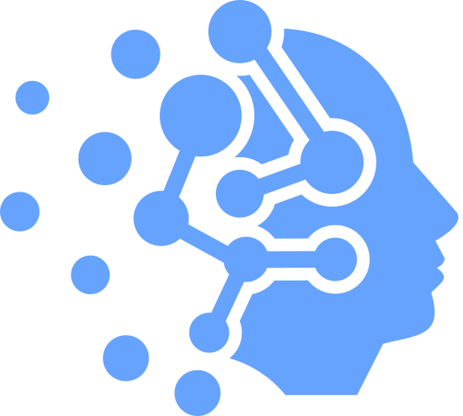


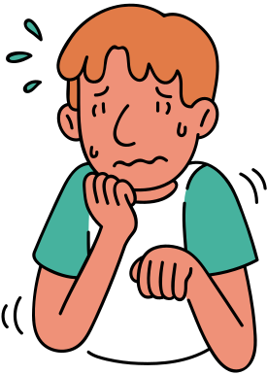





INTRODUCTION
Excited
Angry
Anxious
Sad
01
Mood affects emotions, productivity, and lifestyle
02
Music and quotes can influence mood positively
Happy
Proud
Frustrated
Jealous
03
Aim to build a system that detects mood and suggests quotes + music
02

Slide 3
SYSTEM ARCHITECTURE
Input
01
Image
DeepFace
ML Model
Face/Mood Detection
02
ZenQotes
Spotify
03
API
Quote
English Song
04
Output
Bangla Song
03

Slide 4



TOOLS & TECHNOLOGIES
Backend
Flask
Emotion
Recognition
DeepFace
API (Quotes)
ZenQuotes
API (Music)
Spotify
HTML, CSS, JavaScript
FrontEnd
04

Slide 5

FEATURES
Detects mood accurately from uploaded image
Suggests motivational quotes
Recommends 2 songs per mood:
1 English song
1 Bangla song
Supports Next & Previous navigation
Simple and attractive frontend interface
05

Slide 6

FUTURE WORK
01
Train custom dataset for higher accuracy
02
Add more languages & local music sources
03
Implement personalized recommendations
04
Mobile app version in future
06

Slide 7

CONCLUSION
& Q&A
Mood detection + recommendation system
Integrates Machine Learning with APIs
Provides motivational quotes & bilingual songs
Enhances emotional well-being
07

Slide 8

THANK YOU
FOR YOUR ATTENTION
08

